Slide 1

Azure Stack Meetup
Automation Magic in the Hybrid Cloud!

Slide 2



Sponsors

Slide 3
Agenda
Automated Tenant On-boarding Demo by Chris Black, Bailey Lawson and Daniel Brennand
Service Fabric Cluster Deployment Demo by Chris Black and Yasmin Suleiman
Terraforming the Hybrid Cloud by Alexa Evans and Chris Black
Break
Super Secret Guest Speaker
MVP Guest Speaker: Kenny Lowe
Finish/Time to drink far too much
19:10 – 19:40
19:40 – 20:10
20:10 – 20:40
20:40 – 20:45
20:45 – 21:30
21:30 – 22:00
22:00 – Whenever

Slide 4







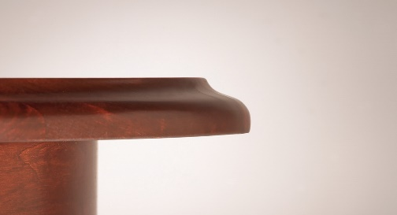
Event Hosts – Who are We?
Chris Black – Azure Stack Technical Authority – Nerd
Bailey Lawson – Azure Stack Engineer – Steve Jobs/Yeti
Alexa Evans – Azure Stack Analyst
Yasmin Suleiman – Azure Stack Analyst Intern
Daniel Brennand – Azure Stack Analyst Intern
Kenny Lowe – Azure Stack MVP – Bus mechanic
Darren Small – Intelligent Edge Global Black Belt, EMEA Black Belt – on Edge

Slide 5
Few questions… ☺ - Show of hands
How many of you used Azure before?
How many of you used Azure Stack before?
How many of you are DevOps?
How many of you are automating your IT processes?
How many of you are using Orchestration tools?

Slide 6
Azure Stack related interesting new things…
Windows Server 2019 – Azure Stack moved from Server 2016 to 2019 in 1908 https://azurestack.blog/2019/09/azure-stack-it-is-time-to-party-like-it-is-2019/
.NET Core for Partner Centre module (Microsoft Customer Agreement vs Microsoft Cloud Agreement)
Azure Stack HCI – more vendors available!!!
Microsoft Ignite 2019 (4^{th –} 8th November) Orlando Florida in 1 week's time!
Hotfix 1.1908.6.37 breaks Network Resource Provider – new Hotfix released to fix it -> 1.1908.8.41
Get Azure Stack logs is now available via Admin Portal – no ERCS required! Also, can be set (via UI ;-() to automatically collect logs! (waiting for MSFT to give us APIs to schedule automatically)
You can now remove Azure Stack tenants without needed to clean up their resources! Previously it would leave them stranded!

Slide 7




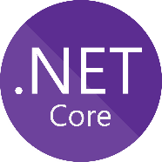



Automated Tenant On-boarding Demo
Azure Public
6
Azure Stack
Authentication
+
Authorisation
On-boarding
VS
Custom CMDB

Slide 8






Service Fabric flow
ASP.NET
.NET
Voting App
Certificate
Key Vault
Notes:
Service Fabric is a distributed systems platform that makes it easy to, deploy, and manage scalable and reliable microservices and containers.

Slide 9
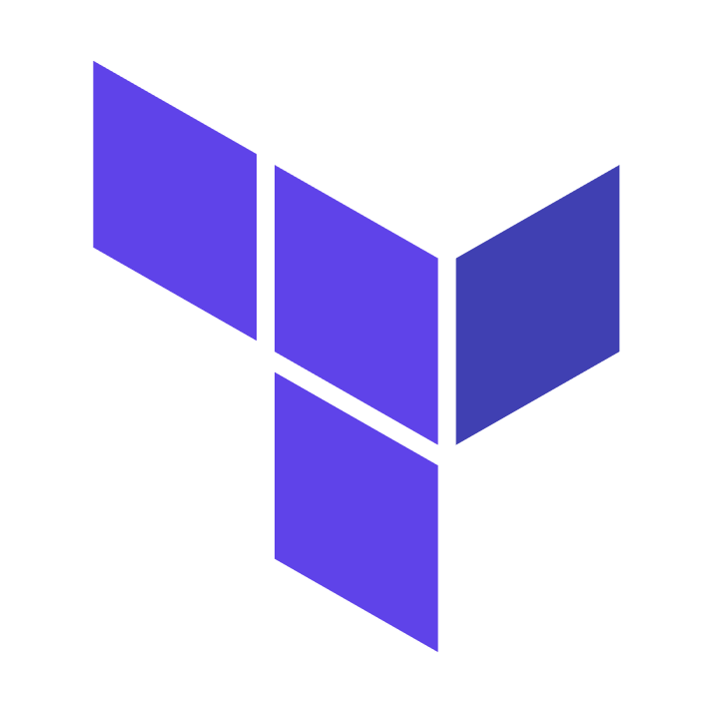

Terraforming the Hybrid Cloud
Azure Public
1 Template
Azure Stack
Why automate deployment?
True hybrid deployment of infrastructure
Infrastructure as Code (IaaC)
Teardown and replicate anywhere

Slide 10
Useful Links
My blog -> https://theblackcloud.tech/ - desert storm
Presentation Repo -> https://github.com/UKCloud/AzureStack - best repo ever made
Knowledge Centre -> https://docs.ukcloud.com - best website on the Internet
Terraform -> https://www.terraform.io/docs/providers/azurestack/ - somebody should look at it
MS Docs -> https://docs.microsoft.com/en-us/azure-stack/user/ https://docs.microsoft.com/en-us/azure-stack/operator/ - well those are mostly wrong ;-)
Happy Azure Stacking!!! ☺☺☺☺☺

Slide 11
Azure Stack is not a brand… it is a way of life!!!!!!! ☺

